Slide 1
Passenger Railroad Management System
Noah Laskowski, Nick Soltysiak, and Brandon Scoppa

Slide 2
Application Scenario and Problem Statement
Problem Statement:
We are building an application that will regulate train traffic in and out of train stations, allow for on-time arrivals and departures, and ensure passenger, crew, and train safety.
Application Scenario:
People wanting to take trips across the east coast of the United States are able to schedule their trip on the railway with our application. Users can choose their preferred trip departure and arrival times, stations, and tracks.

Slide 3
Functional Requirements
Customer can create an account
A customer can create reservations
A reservation can be created by only one customer
A train station can have many tracks
A track can belong to only one train station
A train station can have many trains departing/arriving
A train can depart/arrive at many stations
A track can have many trains traveling on it
A train can only be on one track at a given time
A train can hold many reservations
A reservation can belong to only one train

Slide 4
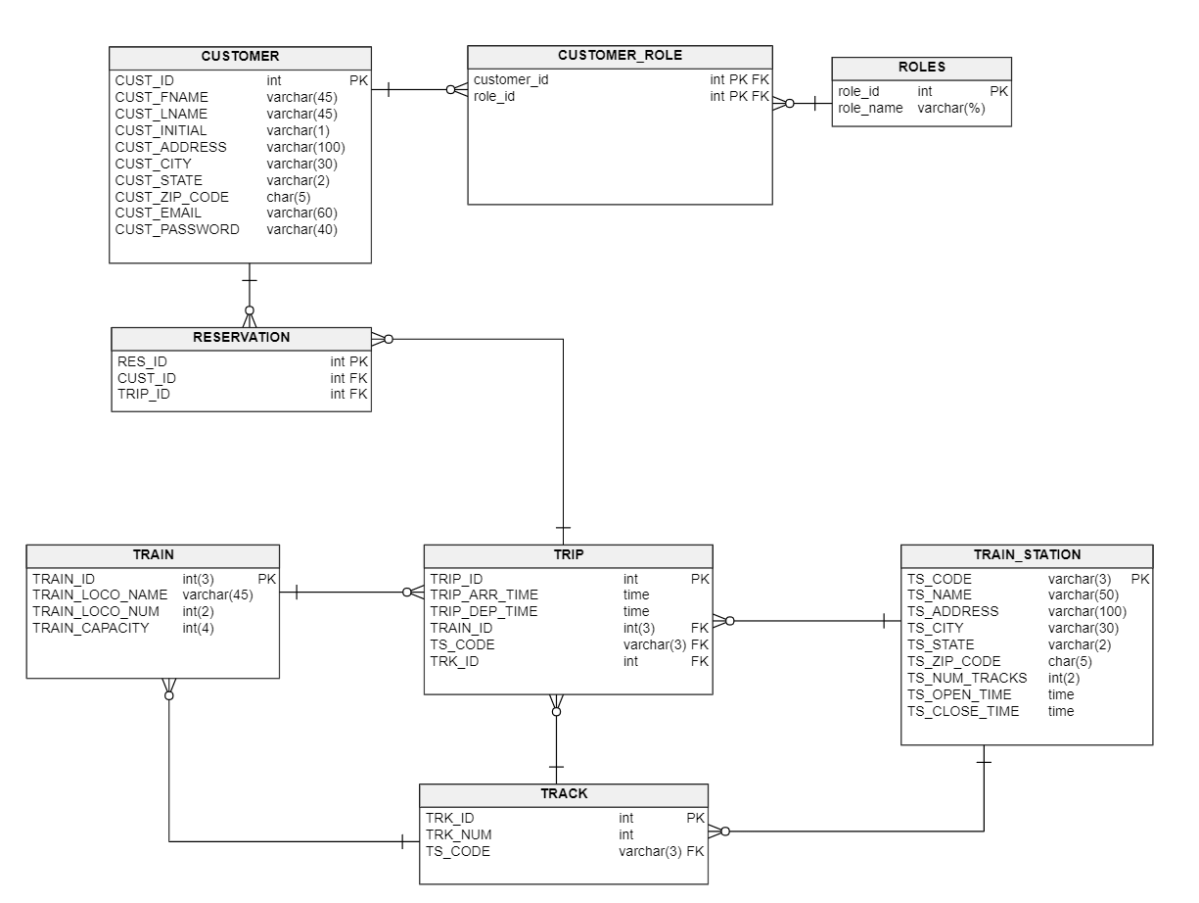
ER-Diagrams

Slide 5
Tools and Technologies
PHP
Javascript
Bootstrap
PHPMyAdmin
MySQL Workbench

Slide 6
Link to Project

